Slide 1
Department Of Computer Science, CUI Lahore Campus
Lecture - 7 Functions

Slide 2
Application of Functions
Define discrete structures such as sequences and strings
Represent the time that a computer takes to solve problems of a given size
Represent the complexity of algorithms
…

Slide 3
Functions
In many examples we assign to each element of a set, a particular element of a second set (which may be the same as the first).
For example, suppose that each student in a discrete structures class is assigned a letter grade from the set {A, B, C, D, F}.
This assignment is an example of a function.
Ali
Babar
Umer
Imran
Hamza
A
B
C
D
F

Slide 4
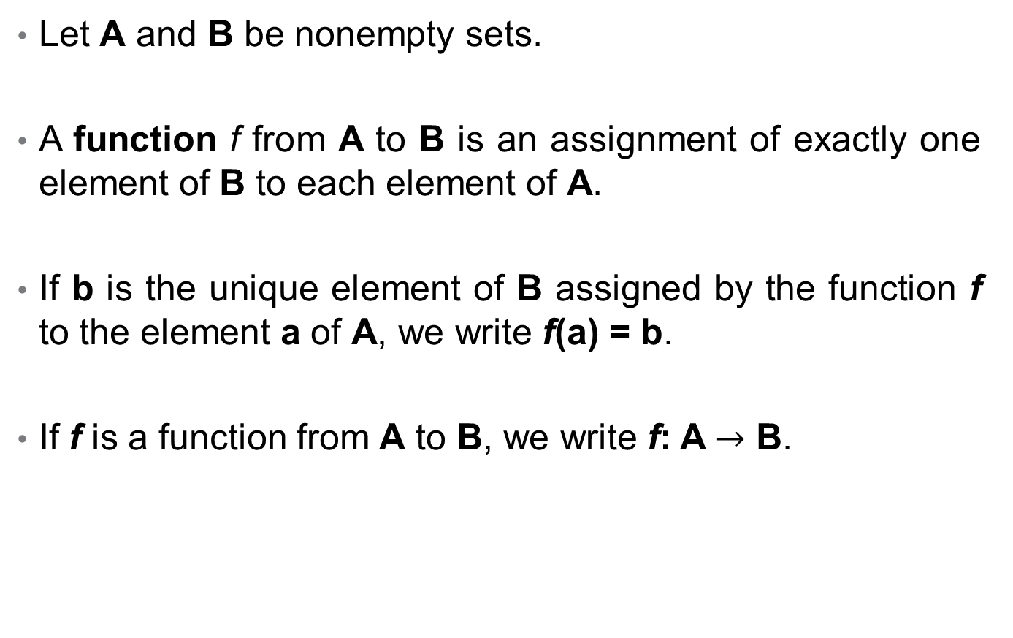
Functions
Let A and B be nonempty sets.
A function f from A to B is an assignment of exactly one element of B to each element of A.
If b is the unique element of B assigned by the function f to the element a of A, we write f(a) = b.
If f is a function from A to B, we write f: A $→$ B.

Slide 5
Functions
If f is a function from A to B, we say that A is the domain of f and B is the codomain of f.
if f(a) = b, we say that b is the image of a and a is the pre-image of b.
The range of f is the set of all images of elements of A.
Also, if f is function from A to B, we say that f maps A to B.

Slide 6
Functions
A function takes an element from a set and maps it to a UNIQUE element in another set.
f maps R to Z
Domain
R
Z
Co-domain
f
f(4.3)
4.3
4
Pre-image of 4
Image of 4.3

Slide 7
Arrow Diagram of Functions
The definition of a function implies that the arrow diagram for a function f has the following two properties:
Every element of A has an arrow coming out of it.
No elements of A has two arrows coming out of it that point to two different elements of B.

Slide 8
Arrow Diagram of Functions(example)
The pre-image
of 1
The image
of “a”
Domain
Co-domain
Ali
Babar
Umer
Hamza
Amir
A
B
C
D
F
“a”
“bb“
“cccc”
“dd”
“e”
1
2
3
4
5
A class grade function
A string length function
g(Ali) = A
g(Babar) = C
g(Umer) = A
…
f(x) = length x
f(“a”) = 1
f(“bb”) = 2
…

Slide 9
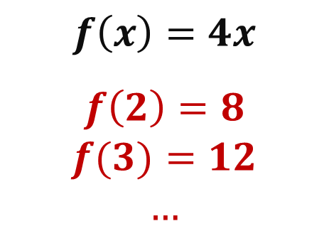
Arrow Diagram of Functions(example)
2
3
4
5
6
12
20
24
8
16
$$f\left(x\right)=4x$$
$$f\left(2\right)=8$$
$$f(3)=12$$
$$…$$

Slide 10
Functions
The range of f is the set of all images of elements of A.
Range
a
e
i
o
u
1
2
3
4
5

Slide 11
Functions
“a”
“bb“
“cccc”
“dd”
“e”
1
2
3
4
5
Not a valid function

Slide 12
Functions and Non-Functions
Which of the arrow diagrams define functions from
A = {2,4,5,6,7} to B = {1,2,4,6,8}.
Domain
Co-domain
Domain
Co-domain
2
4
5
6
7
1
2
4
6
8
2
4
5
6
7
1
2
4
6
8
A
B
A
B
Not a Function
Not a Function

Slide 13
Example
Let f : Z → Z
assign the square of an integer to this integer
What is f (x) =?
f(x) = x²
What is domain of f ?
Set of all integers
What is codomain of f ?
Set of all integers
What is the range of f ?
{0, 1, 4, 9, . . . }. All integers that are perfect squares

Slide 14
Function Arithmetic
Just as we are able to add (+), subtract (-), multiply (*), and divide (÷) two or more numbers, we are able to + , - , * , and ÷ two or more functions.
Let f and g be functions from A to R. Then f + g, f – g, f * g and f/g are also functions from A to R defined for all x ∈ A by:
(f + g)(x) = f(x) + g(x)
(f - g)(x) = f(x) - g(x)
(f *g)(x) = f (x)*g(x)
(f/g)(x) = f(x)/g(x) given that g(x)≠0

Slide 15
Function Arithmetic
Let f₁ and f₂ be functions from R to R such that:
f₁(x) = 2x
f₂(x) = x²
Find f₁ + f₂ and f₁*f_{2.}
f₁+f₂ = (f₁+f₂)(x) = f₁(x)+f₂(x) = 2x+x²
f₁*f₂ = (f₁*f₂)(x) = f₁(x)*f₂(x) = 2x*x² = 2x³

Slide 16
Function Arithmetic
Let f and g be functions from R to R such that:
f (x) = 3x+2 g (x) = -2x + 1
What is the function f *g?

Slide 17
Function Arithmetic
Let f and g be functions from R to R such that:
f (x) = 3x+2 g (x) = -2x + 1
What is the function f *g?
f*g = (f*g) (x) = f (x)*g(x) = (3x+2)*(-2x+1) = -6x²- x +2

Slide 18
Function Arithmetic
Let f and g be functions from R to R such that:
f (x) = 3x+2 g (x) = -2x + 1
What is the function f *g?
f*g = (f*g) (x) = f (x)*g(x) = (3x+2)*(-2x+1) = -6x²- x +2
Let x = -1, What is f(-1)*g(-1) and (f*g)(-1)?

Slide 19
Function Arithmetic
Let f and g be functions from R to R such that:
f (x) = 3x+2 g (x) = -2x + 1
What is the function f *g?
f*g = (f*g) (x) = f (x)*g(x) = (3x+2)*(-2x+1) = -6x²- x +2
Let x = -1, What is f(-1)*g(-1) and (f*g)(-1)?
f (-1) = 3(-1) + 2 = -1
g(-1) = -2(-1) + 1= 3
f(-1)*g(-1) = -1×3 = -3
(f *g) (-1) = -6(-1)2 – (-1) + 2 = -6+1+2 = -3

Slide 20
Function Arithmetic
let f(x)=5x+2 and g(x)=x² -1, At x=4, f(4)=22 and g(4)=15.
Arithmetic Expression | Combine evaluate | Evaluate, then combine
(f+g)(x) (5x+2) + (x²-1) =x²+5x+1 | (f+g)(4) 4²+5(4)+1 =16+20+1 =37 | f(4)+g(4) 22+15 =37
(f-g)(x) (5x+2) - (x²-1) =-x²+5x+3 | (f-g)(4) -4²+5(4)+3 =-16+20+3 =7 | f(4)-g(4) 22-15 =7
(f*g)(x) (5x+2)*(x²-1) =5x³+2x²-5x-2 | (f*g)(4) 5(4³)+2(4²)-5(4)-2 =5(64)+2(16)-20-2 =330 | f(4)*g(4) 22*15 =330
(f/g)(x) (5x+2)/(x²-1) | (f/g)(4) [5(4)+2]/[4²-1] =22/15 | f(4)/g(4) 22/15

Slide 21
One-to-One Function
A function is one-to-one if each element in the co-domain has a unique pre-image
Formal definition: A function f is one-to-one if f(a) = f(b) implies a = b for all a and b in the domain of f.
a
e
i
o
1
2
3
4
5
a
e
i
o
1
2
3
4
5
A one-to-one function
A function that is
not one-to-one

Slide 22

One-to-One Function
$f$is one-to-one using quantifiers as
$∀a∀b\left(f\left(a\right)=f\left(b\right)→a=b\right)$or equivalently $∀a∀b\left(a≠b→f(a)≠f\left(b\right)\right)$
Where $a$ and $b$ in domain of $f$.

Slide 23
More on One-to-One Functions
Injective is synonymous with one-to-one
“A function is injective”
A function is an injection if it is one-to-one
Note that there can be un-used elements in the co-domain
a
e
i
o
1
2
3
4
5
A one-to-one function

Slide 24
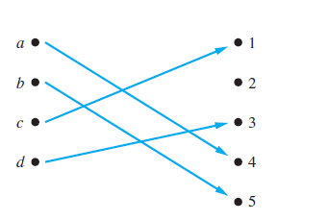

Example one-to-one function
Determine whether the function $f$ from $\{a, b, c, d\}$to $\{1, 2, 3, 4, 5\}$ with $f\left(a\right)=4, f\left(b\right)=5, f\left(c\right)=1, and$
$f(d)=3$is one-to-one.

Slide 25
Onto Functions
A function is onto if each element in the co-domain is an image of some pre-image
Formal definition: A function f is onto if for all b ∈ B, there exists a ∈ A such that f(a) = b.
a
e
i
o
u
1
2
3
4
a
e
i
o
1
2
3
4
5
An onto function
A function that is not onto

Slide 26

Onto functions
A function$f$is onto if $∀b∃a(f\left(a\right)=b)$, where the domain for $a$ is the domain of the function and the domain for $b$ is the codomain of the function.

Slide 27
More on Onto Functions
Surjective is synonymous with onto
“A function is surjective”
A function is a surjection if it is onto
Note that there can be multiple used elements in the co-domain
a
e
i
o
u
1
2
3
4
An onto function

Slide 28
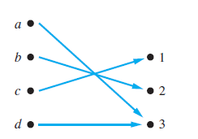

Example onto function
Determine whether the function $f$ from $\{a, b, c, d\}$to $\{1, 2, 3\}$ defined by $f\left(a\right)=3, f\left(b\right)=2, f\left(c\right)=1, and$
$f(d)=3$. Is $f$ an onto function?

Slide 29
Onto vs One-to-One
Are the following functions onto, one-to-one, both, or neither?
a
b
c
1
2
3
4
a
b
c
d
1
2
3
4
a
b
c
1
2
3
4
1-to-1, not onto
Both 1-to-1 and onto
Not a valid function
a
b
c
d
1
2
3
a
b
c
d
1
2
3
4
Onto, not 1-to-1
Neither 1-to-1 nor onto

Slide 30
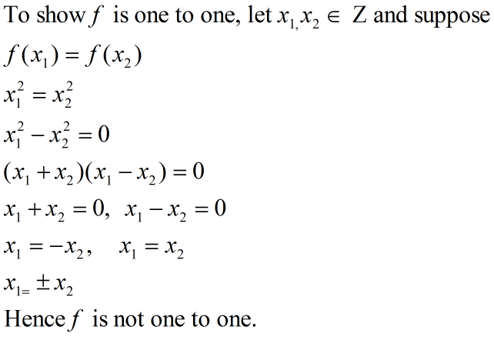

Example
Determine whether the function f (x) = $x^{2}$ from the set of integers to the set of integers is one-to-one.
$$f:Z→Z; f\left(x\right)=x^{2}$$

Slide 31
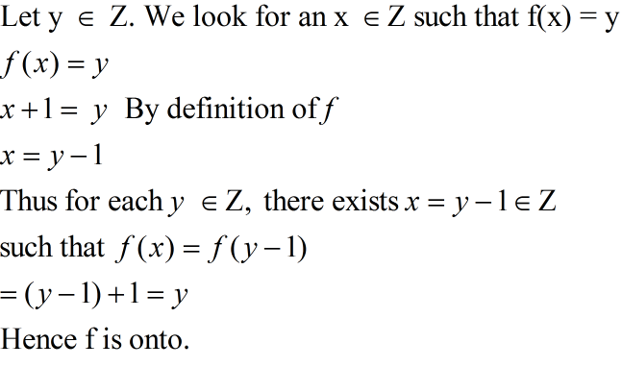

Example
Determine whether the function f (x) = $x+1$ from the set of integers to the set of integers is onto.
$$f:Z→Z; f\left(x\right)=x+1$$

Slide 32
Bijections
Consider a function that is both one-to-one and onto:
Such a function is a one-to-one
correspondence, or a bijection.
a
b
c
d
1
2
3
4

Slide 33

Example
Determine whether the following functions are bijective or not?
$$f:R→R; f\left(x\right)=x^{3}$$
$f:R−\{0\}→R; f\left(x\right)=\frac{x+1}{x}$

Slide 34
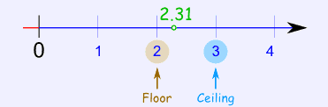
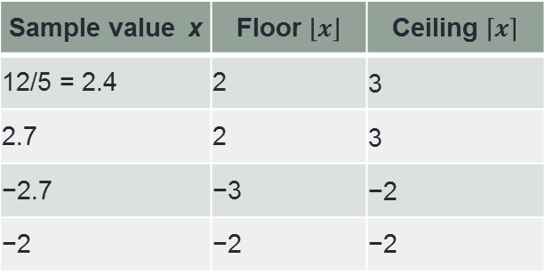

Floor and Ceiling
floor(x) = $\left\lfloor X\right\rfloor$ is the largest integer that is less than or equal to x and ceiling(x) = $\left\lceil X\right\rceil$ is the smallest integer that is greater than or equal to x
The floor and ceiling functions give you the nearest integer up or down.
Sample value x | Floor $\left\lfloor x\right\rfloor$ | Ceiling $\left\lceil x\right\rceil$
12/5 = 2.4 | 2 | 3
2.7 | 2 | 3
−2.7 | −3 | −2
−2 | −2 | −2

Slide 35
Identity Functions
A function such that the image and the pre-image are ALWAYS equal
f(x) = 1*x
f(x) = x + 0
The domain and the co-domain must be the same set.

Slide 36
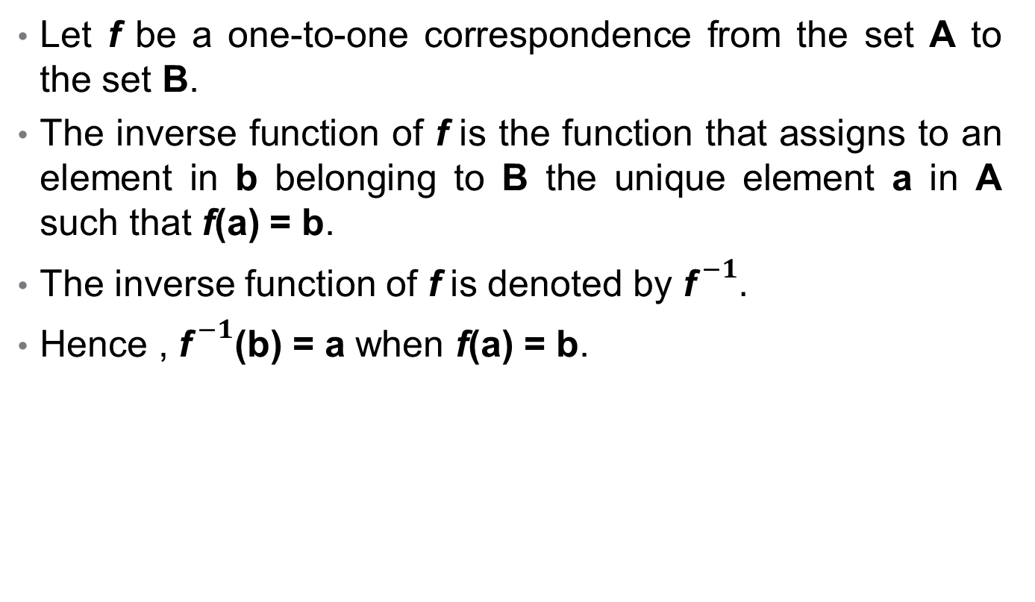
Inverse Function
Let f be a one-to-one correspondence from the set A to the set B.
The inverse function of f is the function that assigns to an element in b belonging to B the unique element a in A such that f(a) = b.
The inverse function of f is denoted by ${\text{f}}^{ −1}.$
Hence , ${\text{f}}^{ −1}$(b) = a when f(a) = b.

Slide 37
Inverse Functions
If f(a) = b, then f⁻¹(b) = a
A
B
f
a= f⁻¹(b)
f(a)=b
f⁻¹
A=domain of f
B=Co-domain of f

Slide 38
Inverse Functions
If f(x) = y, then f⁻¹(y) = x
Let f(x) = 2*x
f(x)=y
R
f
R
f⁻¹
f(4.3)
4.3
8.6
f⁻¹(8.6)
Then f⁻¹(y) = y/2

Slide 39
More on Inverse Functions
Can we define the inverse of the following functions?
An inverse function can ONLY be done defined on a bijection
a
b
c
1
2
3
4
a
b
c
d
1
2
3
What is f⁻¹(2)?
Not onto!
What is f⁻¹(2)?
Not 1-to-1!

Slide 40
More on Inverse Functions
A one-to-one correspondence is called invertible because we can define an inverse of this function.
A function is not invertible if it is not a one-to-one correspondence, because the inverse of such a function does not exist.

Slide 41
Example
Let f be the function from {a, b, c} to {1, 2, 3} such that
f (a) = 2, f (b) = 3, and f (c) = 1.
Is f invertible, and if it is, what is its inverse?

Slide 42
Example
Let g be the function from {a, b, c, d} to {1, 2, 3, 4}
such that
g(a) = 3, g (b) = 4, g(c) = 1, and g(d) = 3.
Is g invertible, and if it is, what is its inverse?

Slide 43

Working Rule to Find Inverse Function
Let f: X $→$Y be a one-to-one correspondence defined by the formula f(x) = y.
Solve the equation f(x) = y for x in terms of y.
${\text{f}}^{ −1}$(y) equals the right hand side of the equation found in step 1.

Slide 44
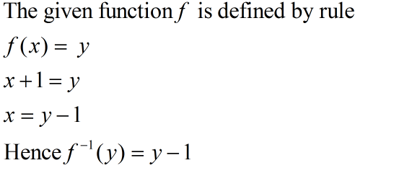

Example
$$\text{Let} \text{f}\text{ : }\text{Z}\text{ → }\text{Z} \text{be} \text{such} \text{that} \text{f}\text{ (}\text{x}\text{) = }\text{x}\text{ + 1. }\text{Is} \text{f} \text{invertible}\text{, }\text{and} \text{if} \text{it} \text{is}\text{, }\text{what} \text{is} \text{its} \text{inverse}\text{?}$$

Slide 45

Compositions of Functions
Let g be a function from the set A to the set B and let f be a function from the set B to the set C. the compositions of the functions f and g, denoted by f $°$g, is defined by
$$\text{(}\text{f} °\text{g}\text{)(}a\text{)}=\text{f} \text{(}\text{g}\text{(}\text{a}\text{))}$$

Slide 46
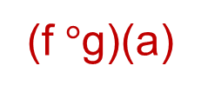
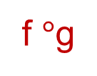
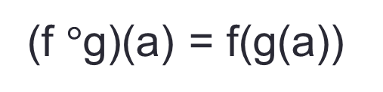
Compositions of Functions
(f $°$g)(a) = f(g(a))
f $°$g
A
B
C
g
f
g(a)
f(b)
a
f(g(a))
b = g(a)
(f $°$g)(a)

Slide 47
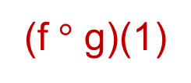
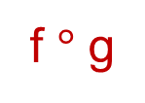
Compositions of Functions
Let f(x) = 2x+3 Let g(x) = 3x+2
f $°$ g
R
R
R
g
f
g(1)
f(5)
f(g(1))=13
1
g(1)=5
(f $°$ g)(1)
f(g(x)) = 2(3x+2)+3 = 6x+7

Slide 48
Compositions of Functions
Does f(g(x)) = g(f(x))?
Let f(x) = 2x+3 Let g(x) = 3x+2
f(g(x)) = 2(3x+2)+3 = 6x+7
g(f(x)) = 3(2x+3)+2 = 6x+11
Function composition is not commutative!
Not equal!

Slide 49

Compositions of Functions
Let A = {1,2,3,4,5}
f : A $→$A and g : A $→$A
f(1) = 3, f(2) = 5, f(3) = 3, f(4) = 1, f(5) = 2
g(1) = 4, g(2) = 1, g(3) = 1, g(4) = 2, g(5) = 3
Find the composition functions f ◦ g and g ◦ f .
f ◦ g | g ◦ f
(f ◦ g ) (1) = f(g(1)) = f(4) =1 | (g ◦ f ) (1) = g(f(1)) = g(3) = 1
(f ◦ g ) (2) = ? | (g ◦ f ) (2) = ?
(f ◦ g ) (3) = ? | (g ◦ f ) (3) = ?
(f ◦ g ) (4) = ? | (g ◦ f ) (4) = ?
(f ◦ g ) (5) = ? | (g ◦ f ) (5) = ?

Slide 50
Compositions of Functions
Let A = {1,2,3,4,5}
f : A $→$A and g : A $→$A
f(1) = 3, f(2) = 5, f(3) = 3, f(4) = 1, f(5) = 2
g(1) = 4, g(2) = 1, g(3) = 1, g(4) = 2, g(5) = 3
Find the composition functions f ◦ g and g ◦ f .
f ◦ g | g ◦ f
(f ◦ g ) (1) = f(g(1)) = f(4) =1 | (g ◦ f ) (1) = g(f(1)) = g(3) = 1
(f ◦ g ) (2) = 3 | (g ◦ f ) (2) = 3
(f ◦ g ) (3) = 3 | (g ◦ f ) (3) = 1
(f ◦ g ) (4) = 5 | (g ◦ f ) (4) = 4
(f ◦ g ) (5) = 3 | (g ◦ f ) (5) = 1

Slide 51
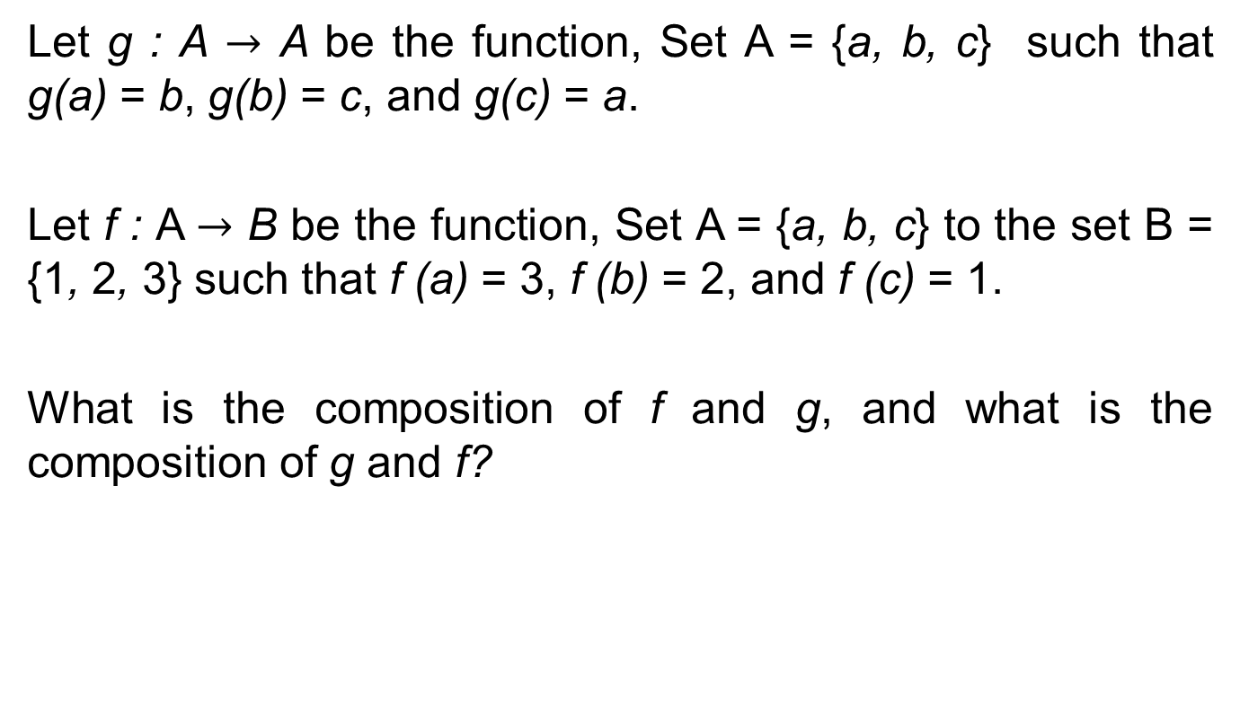
Compositions of Functions
Let g : A $→$ A be the function, Set A = {a, b, c} such that g(a) = b, g(b) = c, and g(c) = a.
Let f : A $→$ B be the function, Set A = {a, b, c} to the set B = {1, 2, 3} such that f (a) = 3, f (b) = 2, and f (c) = 1.
What is the composition of f and g, and what is the composition of g and f?

Slide 52
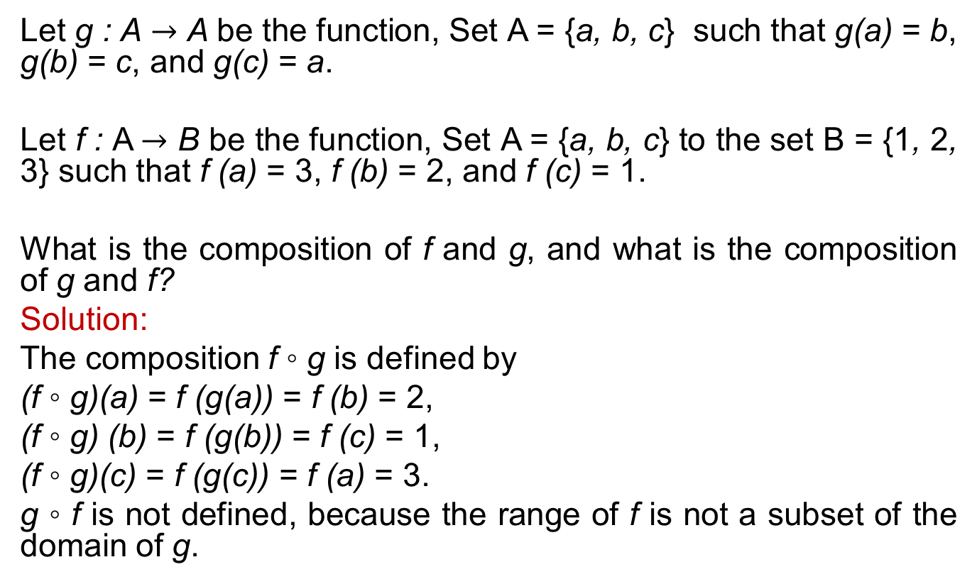
Compositions of Functions
Let g : A $→$ A be the function, Set A = {a, b, c} such that g(a) = b, g(b) = c, and g(c) = a.
Let f : A $→$ B be the function, Set A = {a, b, c} to the set B = {1, 2, 3} such that f (a) = 3, f (b) = 2, and f (c) = 1.
What is the composition of f and g, and what is the composition of g and f?
Solution:
The composition f ◦ g is defined by
(f ◦ g)(a) = f (g(a)) = f (b) = 2,
(f ◦ g) (b) = f (g(b)) = f (c) = 1,
(f ◦ g)(c) = f (g(c)) = f (a) = 3.
g ◦ f is not defined, because the range of f is not a subset of the domain of g.

Slide 53
Exercise Questions
Chapter # 2
Topic # 2.3
Questions 1, 2, 8, 9,10,11,12, 22, 23, 36, 37

